Slide 1


Department of Computer Science and Engineering
FRAME WORK OF ONLINE VOTING SYSTEM WITH FACE RECOGANATION USING BLOCK CHAIN
LALITH KUMAR P [211421104326]
VIJAY MAHARAJ S [211421104334]
PRADEEP C [211421104329]
Guide Name & Designation
Mrs.A. Prabha M.E Assistant professor
Batch No :19

Slide 2
Abstract
A widespread mistrust towards the traditional voting system has made democratic voting in any country very critical. The Chain Security Algorithm applied in the voting system makes the voting transaction more secure. The security of the blockchain based voting system has also been discussed. Additionally, encryption of transactions using cryptographic hash and prevention of attack 51% on the blockchain has also been elaborated. Furthermore, the methodology for carrying out blockchain transactions during the process of voting has been elaborated using Blockchain Finally, the performance evaluation of the proposed system shows that the system can be implemented in a large-scale population.

Slide 3
Introduction
Blockchain can reduce a lot of efforts and resources invested in polling stations, specifying the areas, appointing staff, and preventing security risks at polling stations . Holding a digital election through blockchain not only saves money but also reduces the risk of inequity in the voting process . Modern technologies such as blockchain technology are very secure and bene_cial if used carefully. It can make the voting system more transparent, reliable, and also enhance traceability of transactions . Therefore, using Blockchain technology in the voting system assures that it will be more trustable, secure and consistent as compare to other digital voting systems. Blockchain technology can carry out a transparent voting process while maintaining voter privacy and trust.

Slide 4
Objective of the Project
Project Scope:
The proposed system is the verified online voting system with user face using aadhaar card. It determines the particular voter by his/her face whether he/she is a valid voter or not. It allows particular voter to cast the vote online. The polling process continues until the voting time ends and update the database in the server. A online voting system uses aadhaar card to retrieve the complete details about the voter. And the votes are stored in a block chain server and viewed to the public this ensure a your environment.

Slide 5
Literature Survey
 | Authors | Title | Source | Pages | Date
1 | Ashok Kumar, T. Ummal Sariba Begum | Secure Internet Voting System Based on Biometrics | Proc. Int. Conf. on Biometrics and Security | 125-132 | 2012
2 | Sujith Samuel Mathew, K. Radhakrishnan | An Efficient and Secure Mobile Voting System | Journal of Mobile Security and Privacy | 241-249 | 2013
3 | W. Zhao, R. Chellappa, P. J. Phillips, A. Rosenfeld | Face Recognition: A Literature Survey | ACM Computing Surveys | 399-458 | 2003

Slide 6
Literature Survey
 | Authors | Title | Source | Pages | Date
4 | Omkar M. Parkhi, Andrea Vedaldi, Andrew Zisserman | Deep Learning-Based Face Recognition: A Survey | IEEE Trans. Pattern Analysis & Machine Intelligence | 839-858 | 2015
5 | Shahana T., Dinesh Kumar G. | Block chain-Based Secure Voting System | IEEE Int. Conf. on Block chain Applications | 155-162 | 2018
6 | Peter Y. A. Ryan, Vanessa Teague | Blockchain for Voting: A Systematic Review | IEEE Journal on Block chain and Voting | 211-224 | 2020

Slide 7
Literature Survey
 | Authors | Title | Source | Pages | Date
7 | Abdou M., Zahri Y., Karmouch A. | A Block chain-based E-voting System using Ethereum | Proc. IEEE Int. Conf. on Smart Contracts | 311-318 | 2018
8 | Jayant N., Ashish J. | Block chain-based E-voting System using Biometric Authentication | Int. Journal of Secure Computing | 117-124 | 2020
9 | K. Karthick, G. Karunanithy, S. K. Parvathy | Blockchain and Facial Recognition-based Secure Voting System | Proc. IEEE Conf. on Smart Technologies for Secure Voting | 519-526 | 2021

Slide 8
Problem Statement
Problem Statements
1.Voter Fraud and Impersonation: Current online voting systems lack robust voter authentication mechanisms, leading to potential impersonation and unauthorized access, compromising the integrity of the election.
2.Lack of Vote Security: Votes are vulnerable to tampering, manipulation, and loss, casting doubts on the reliability of the voting process and the authenticity of the results.
3.Absence of Immutable Vote Records: Traditional databases used in voting systems are susceptible to unauthorized modifications, making it difficult to maintain a tamper-proof, permanent voting record.
4.Privacy and Anonymity Concerns: Ensuring voter privacy and securely handling sensitive biometric data (e.g., face recognition) while maintaining vote transparency and anonymity is a critical challenge.
5.Trust Issues in Centralized Systems: Centralized control over voting systems increases the risk of data breaches and manipulation, creating a need for decentralized solutions to enhance trust and transparency.

Slide 9
Proposed System
The proposed online voting system integrates face recognition for voter authentication and blockchain technology for secure, transparent vote storage. In this framework, face recognition is employed to authenticate voters during both the registration and voting phases, ensuring that only legitimate voters can access the system. This use of blockchain ensures that each vote is immutable, tamper-proof, and transparent, providing all stakeholders with the ability to verify the accuracy of the voting results.
Blockchain technology further ensures that all votes are stored in a decentralized manner, eliminating the risk of a single point of failure or manipulation. The system’s architecture consists of a secure client application for voters, a blockchain network for decentralized vote storage, and smart contracts for automated vote processing.

Slide 10
Software / Hardware used
HARDWARE REQUIREMENTs
Hard Disk : 80GB and Above
RAM : 4GB and Above
Processor : P IV and Above
SOFTWARE REQUIREMENTS
Windows 10 and above
JDK 1.8
Python 3.6.3
XAMPP
Gana Che
TECHNOLOGIES USED
JAVA
Block chain

Slide 11



Architecture / Methodology used
Admin
User
Add Election
Register
Upload image
Verify User
Trained Image
Publish Result
Vote for Candidate
Face Verification
Register Vote
Result

Slide 12
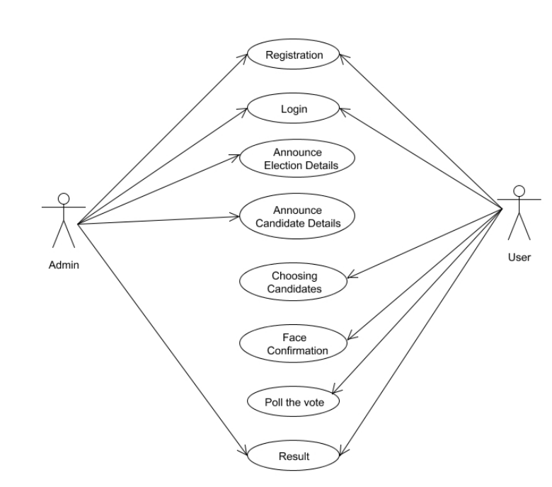
System Design – use case diagram

Slide 13
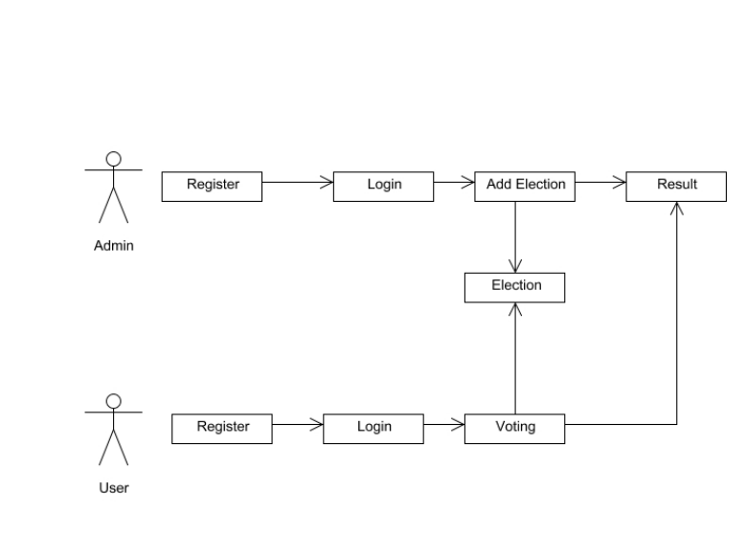
System Design - Collaboration Diagram
Title of the Project

Slide 14
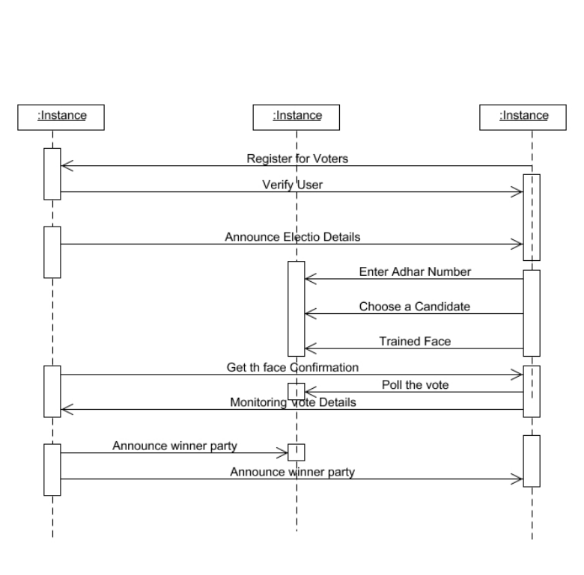
System Design - Squence Diagram
Title of the Project

Slide 15
Module Description
Modules:
User Registration & Trained Voter Face
Create Election
Voting
Publish Result

Slide 16
Module Description
User Registration & Trained Voter Face
User should register in our website (User Voting Page Way) Block chain as an initial step with their mobile name, email, aadhar id, Voter id , image Area, Block chain Address contact number to which an unique USER-ID register. Users who are all registered in this portal are also considered as voter. The voter image convert to trained image After registering successfully the admin verify the voter details, after user can login into their profile using their USER-ID and their registered password.

Slide 17
Module Description
Admin:
Admin Login page with default user name and password. Admin can accept or reject an voter request by verifying the user detail and also admin can register another admin. User has to scan his aadhar card for verification process. After scanning he should enter his detail and send an request to the admin if the account get rejected due to some reason he will be intimated to register again by admin.

Slide 18
Module Description
Create Election
The Admin can create an election with election type and election constituency. All the election gets triggered at the given date and time. And Verified user has to login and scan his Block chain Address if election and user constituency matches user can view Election details. And Block chain Address. To create Nominated account in block chain.

Slide 19
Module Description
Voting
Voters must have access to any web browser to take part in voting. The voter's interface would be provided in English language to make it easy to use for all users. The proposed system can contain a large number of voters at the time of voting. User has to face his registered finger during his registration process..
Voting transactions are sent to a pool from which miners analyze them and remove the malicious request by taking the consensus from the other nodes before adding it to the chain. The votes are fully secured using a cryptographic hash. Each vote cast adds a new block in the chain. the voter of that particular voting transaction is notified through an SMS to his registered email.
Upon successfully completion of transaction the vote has been counted in the whole voting activity.

Slide 20
Module Description
Publish Result
Smart contracts are providing a secure connection between the user and the network while executing a transaction in the chain. These are the rules that are implemented on the entire.
Block chain and cannot be neglected under any condition. All the nodes have to follow the smart contracts to save the vote in the system successfully. When user completes his or her voting process votes are stored in Block chain. User can view his or her vote in a pie chart retrieved from block chain.SHA256 algorithm has been used to hash the data. Admin Can publish the result of each constituency after the election process is fully completed.

Slide 21
Testing /Performance Evaluation / Results
Software Testing Techniques
The system undergoes several software testing techniques to verify the functionality of the face recognition module and the blockchain integration. Unit testing is applied to individual components such as voter registration, biometric authentication, and vote casting. Integration testing ensures that the blockchain interacts seamlessly with the face recognition system and that all transactions are securely recorded. Security testing evaluates the system’s resistance to attacks such as data breaches, unauthorized access, or vote tampering. Additionally, load testing is performed to assess the system’s ability to manage large-scale voting with concurrent users.

Slide 22
Testing /Performance Evaluation / Results
Testing Methods & Key Strategies
Black box testing focuses on the system’s functional behavior, testing voter registration, face recognition authentication, and vote recording without accessing the internal code structure. Meanwhile, white box testing verifies the internal code of the blockchain smart contracts and the face recognition algorithms to identify potential vulnerabilities. Load testing evaluates the system's performance under high-traffic conditions, ensuring the face recognition and blockchain components maintain efficiency under heavy voter loads. Penetration testing is conducted to simulate cyberattacks, ensuring the system is fortified against security threats. Finally, acceptance testing confirms that the system meets all functional and security requirements set by voters and election authorities.

Slide 23
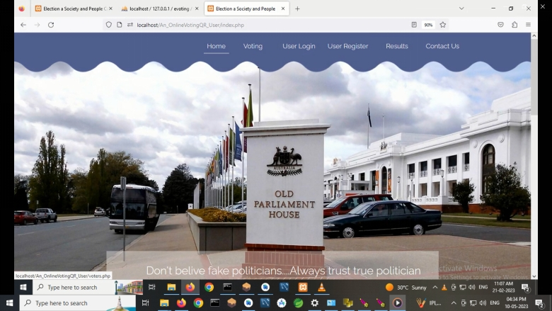
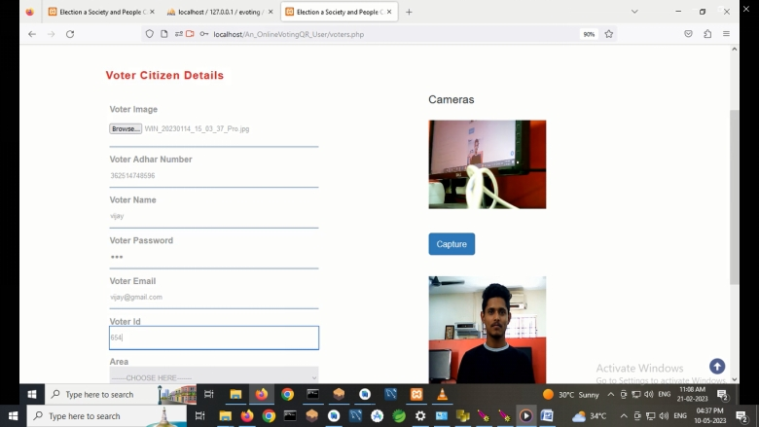
Screen Shots

Slide 24
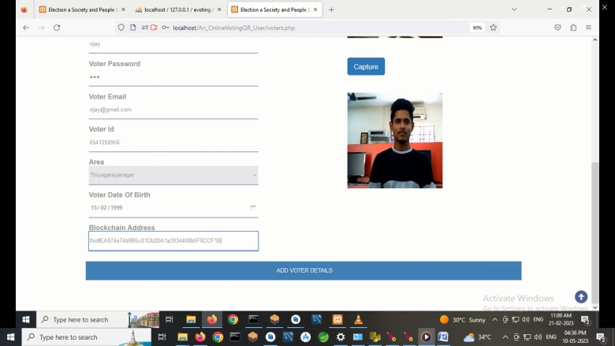
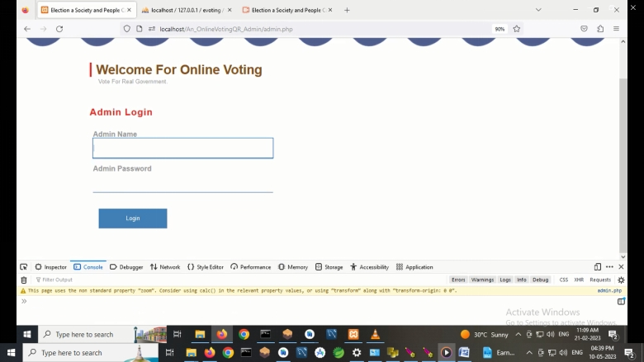
Screen Shots

Slide 25

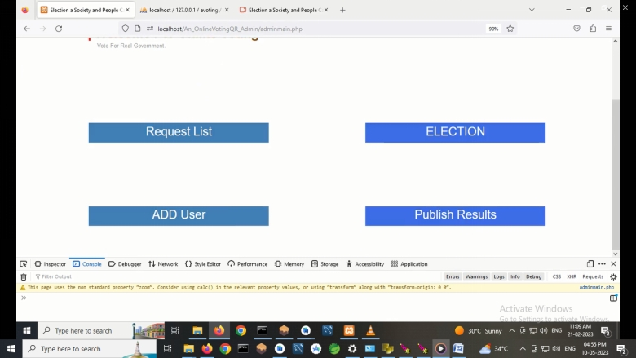
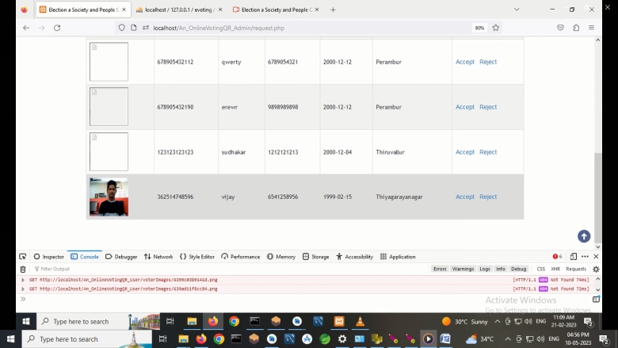

Slide 26
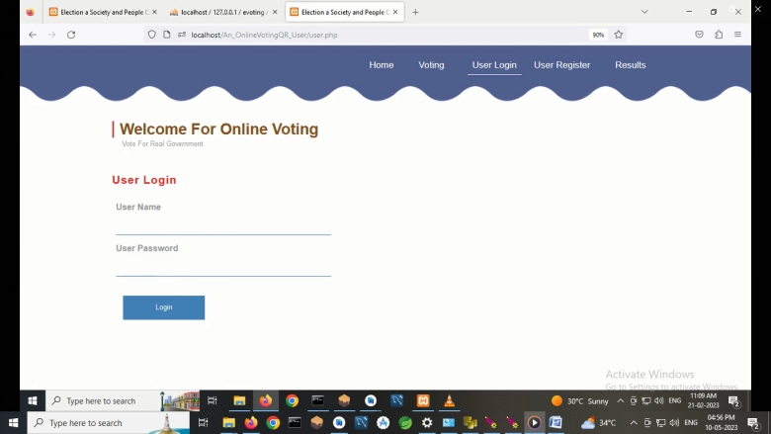
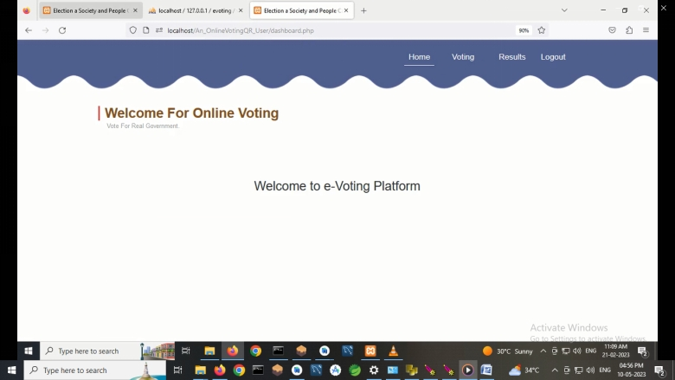
Screen Shots

Slide 27
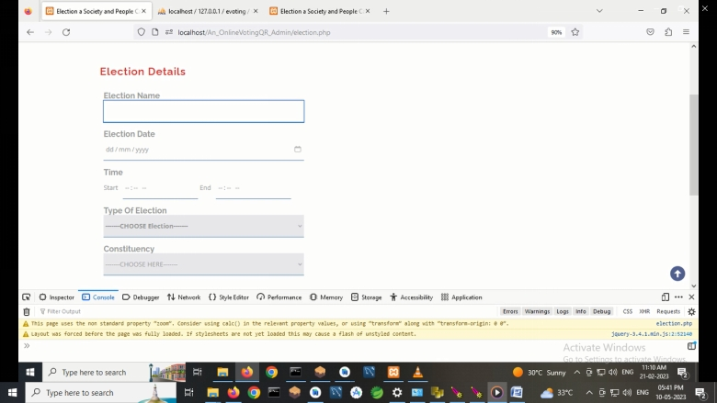
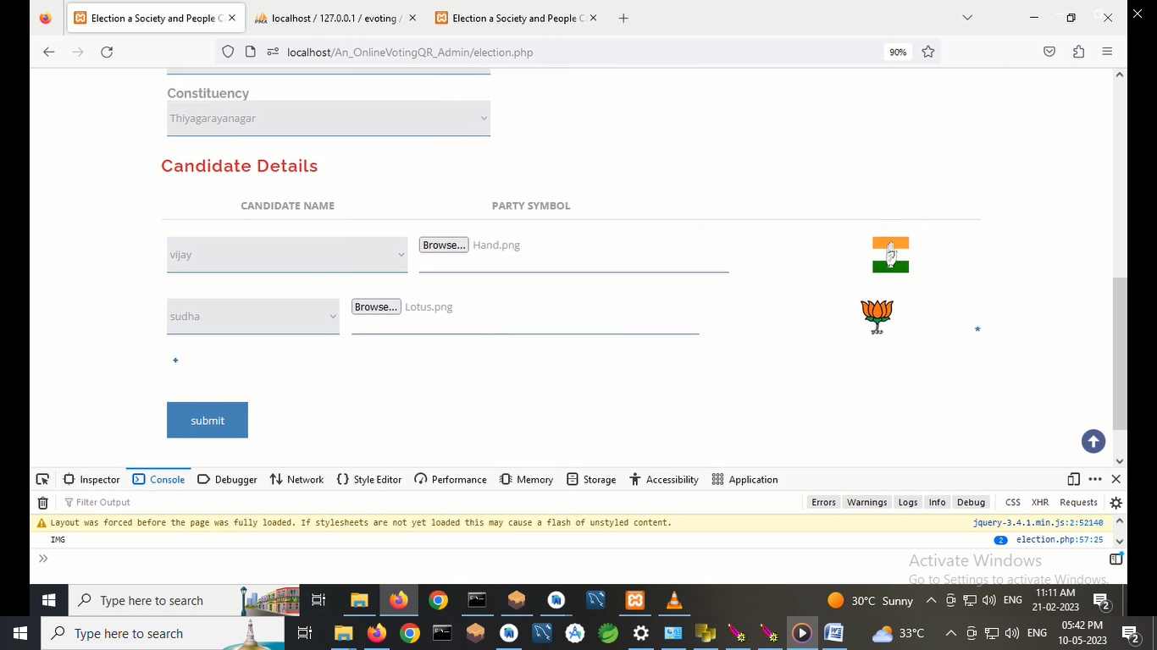
Screen Shots

Slide 28
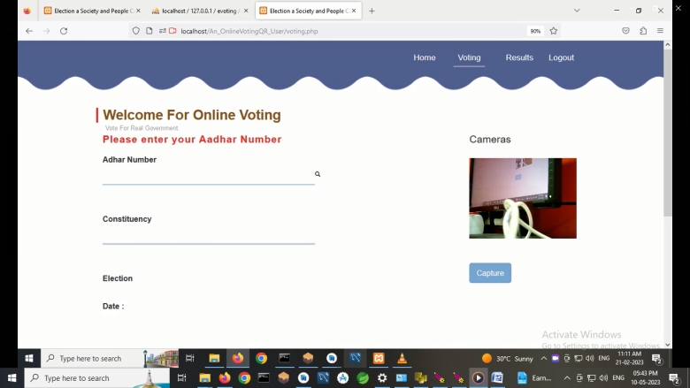
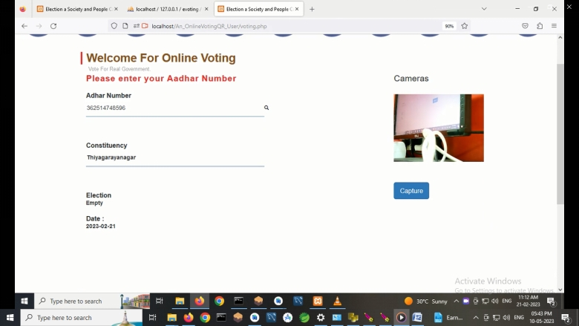
Screen Shots

Slide 29
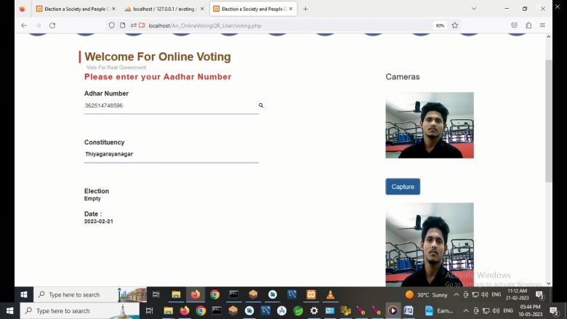
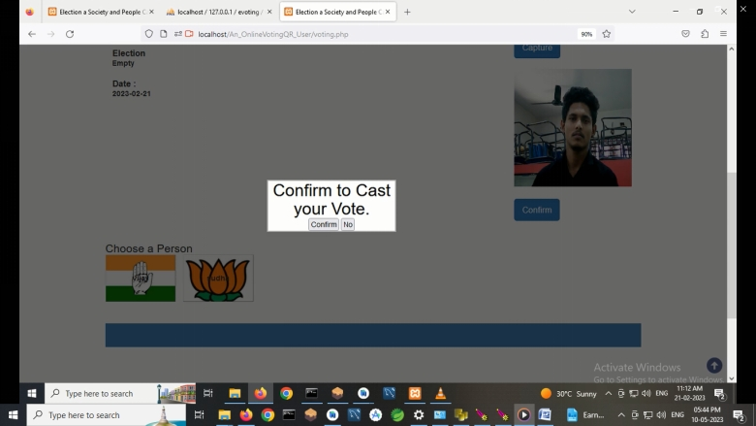

Slide 30
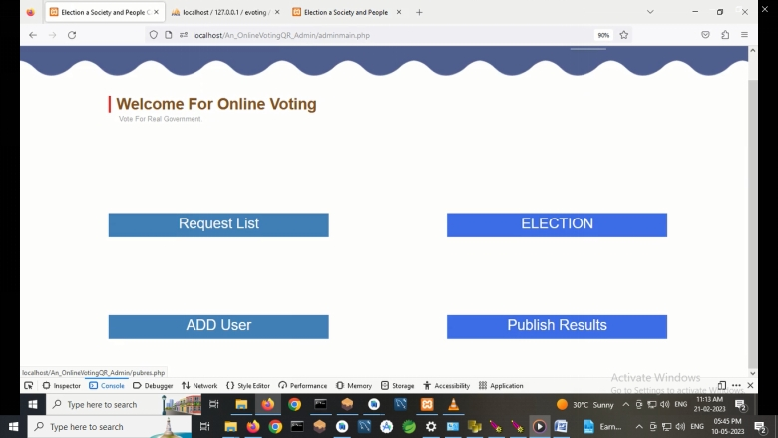
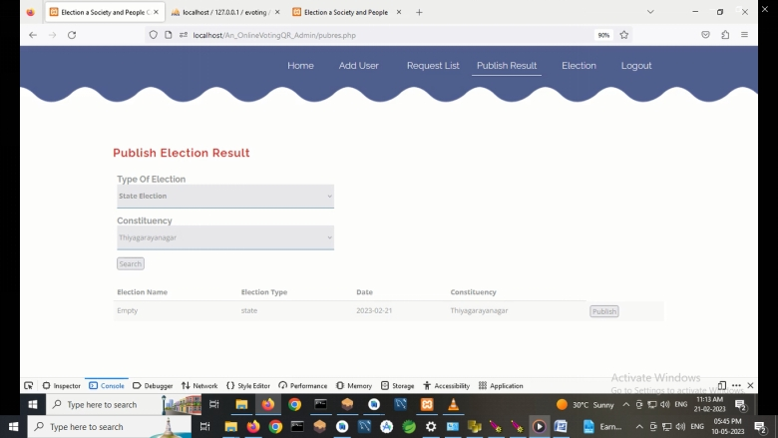
Screen Shots

Slide 31
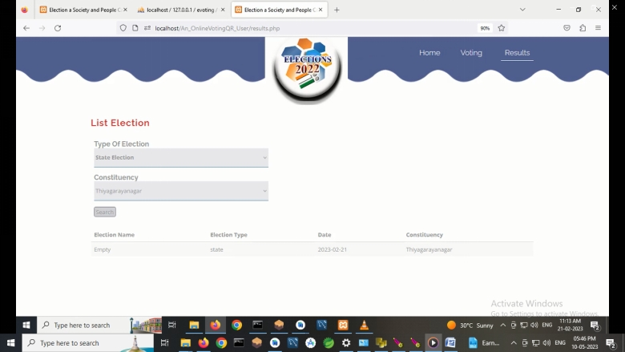
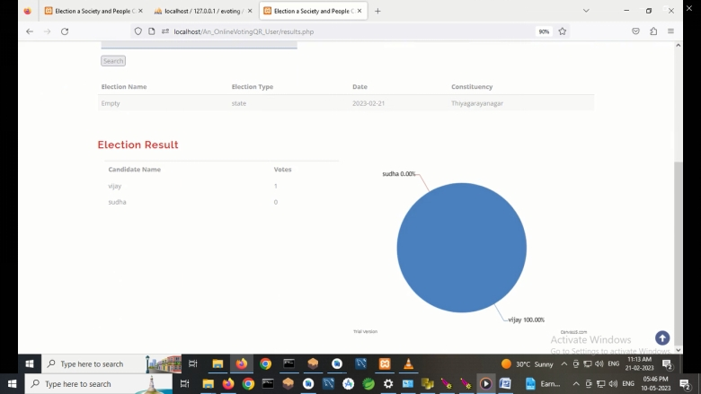
Screen Shots

Slide 32
Conclusion / Feature Enhancement
Future Enhancement:
We focus on improving the security level by guaranteeing the integrity of e-coupon information. For example, the existing e-coupon service uses a database system. In this system, since an administrator can easily obtain the authority, the administrator rather easily modifies the data maliciously. Meanwhile, in our provided service which uses a blockchain system, the administrator cannot easily obtain the authority since the authority should be obtained by the consensus of all users. Also, note that many studies are underway to improve the performance of the blockchain. Therefore, performance issues with blockchain will be mitigated in the future and we also leave the improvement for the performance of blockchain as future work.

Slide 33
Conclusion / Feature Enhancement
Conclusion:
We have investigated e-coupon services that store e-coupon information on a decentralized server. We found that the e-coupon information stored in the server can be manipulated by a malicious attacker or administrator. To handle this issue, we present a new e-coupon service that improves security by exploiting e-coupon smart contracts in a Ethereum blockchain system using Ganache Software. According to our experimental results, the proposed service prevents the manipulation of e-coupon information with higher security and minor performance overhead. In the future, we will focus on improving blockchain performance.

Slide 34
Reference Paper/ URL
https://www.google.com/search?q=FRAME+WORK+OF+ONLINE+VOTING+SYSTEM+WITH+FACE+RECOGANATION+USING+BLOCK+CHAIN&oq=FRAME+WORK+OF+ONLINE+VOTING+SYSTEM++WITH+FACE+RECOGANATION+USING+BLOCK+CHAIN&gs_lcrp=EgZjaHJvbWUyBggAEEUYOTIGCAEQIRgK0gEJMTI1OWowajE1qAIIsAIB8QUTvjDX6WqZ_w&sourceid=chrome&ie=UTF-8

Slide 35
Conference / Publication / Patent Certificate/ Project Contest Winner Certificates

